Slide 2
18.1 Superposition

Slide 3
Example

Slide 4
Amplitude

Slide 5
Effect of φ
Same example, but with different values of φ

Slide 6
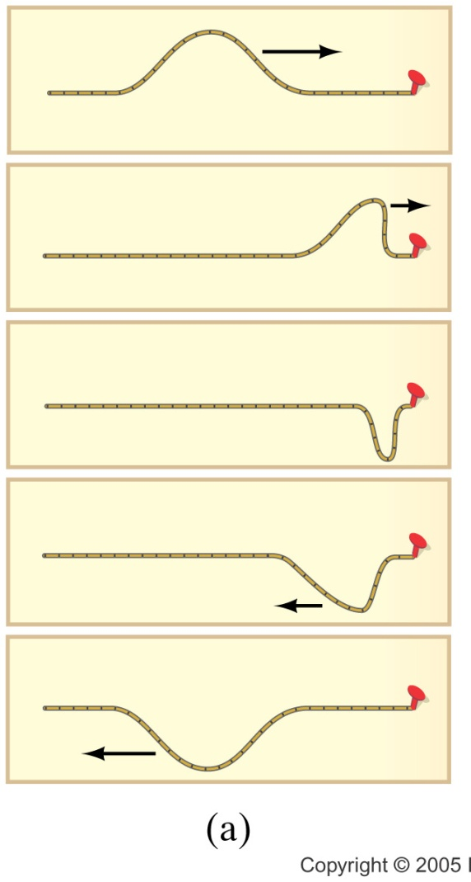
Case One: Fixed End
There is a big change in the medium at the end of the rope.
The rope ends.
There is a person or (as in the figure) some thing holding the rope in place.
This change in medium causes a reflection.
In the fixed end case, the pulse is inverted.
Why?

Slide 8
0s
4s
1s
5s
2s
6s
3s
7s

Slide 9
Forces on the End of the Rope
T_{y}
T_{y}
T
T_{y}
T_{x}
F_{g}
T_{x}
F_{wall}
F_{g}
T
F_{wall}

Slide 10
Reasonable?
Remember back in PH 121 (or statics) the book on the table?
Book has a force due to gravity
Table exerts a force equal to m_{book}g on the book

Slide 11
Demo
See if you can feel that you must provide the force

Slide 12
0s
4s
1s
5s
2s
6s
3s
7s

Slide 13
Forces on the End of the Rope
T_{y}
T_{y}
T
T_{y}
T_{x}
F_{g}
T_{x}
F_{g}
T

Slide 14
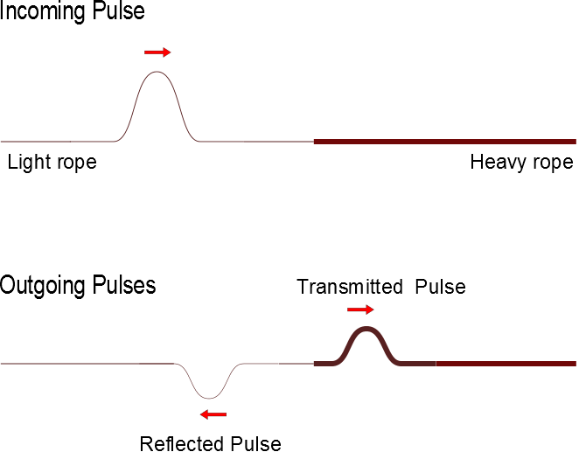
Case 3: Semi-loose End
Now the pulse is partially reflected
RHS rope sees a semi-fixed end point
LHS receives part of the pulse energy
New pulse has been “transmitted”

Slide 15
Forces on the End of the Rope
T_{y}
T_{y}
T
T_{y}
T_{x}
F_{g}
T_{x}
F_{RHS}
F_{g}
F_{RHSl}
T

Slide 16
Consider momentum
When we move from a less dense medium to a more dense medium
Reflected pulse is inverted
Pulse slows down
Which piece is harder to move?

Slide 17
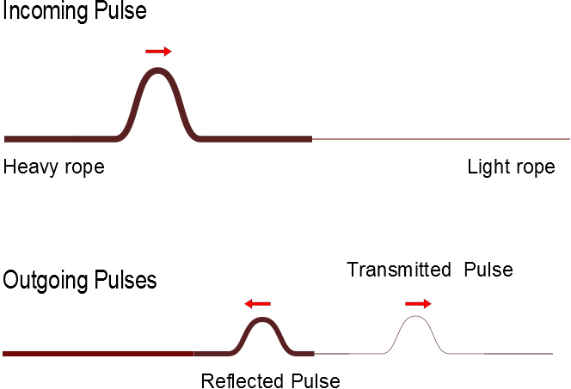

Slide 18
Standing Waves

Slide 19
Anti-Nodes
Nodes

Slide 21
L

Slide 22
18.3 Standing Waves in a String Fixed at Both Ends

Slide 23
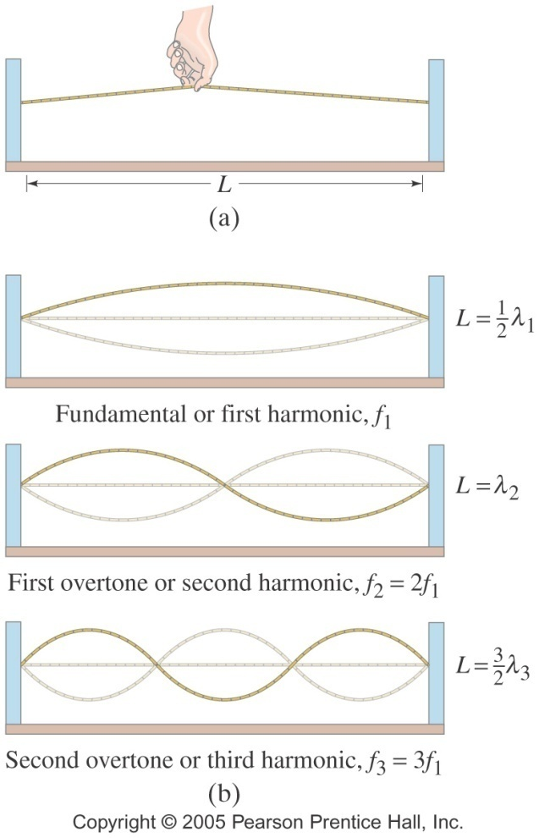
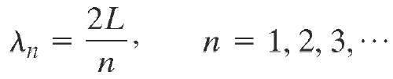

Modes, Wavelengths, Frequencies
The wavelengths and frequencies of standing waves are:

Slide 24


Standing Waves
The wavelengths and frequencies of standing waves are:
(11-19a)
(11-19b)

Slide 25
Summary
Superposition
Standing Waves

Slide 26
Summary
Standing Waves in Strings

